Slide 1
Smoking Around the World
Eric Wolf • Sept 2023

Slide 2
Problem Identification
Smoking Trends Variability
Smoking trends globally have exhibited significant variability since the 1980s.
Variability includes daily cigarette consumption, percentage of male and female smokers, and total smoker counts.
Analyzing the Data for Overall Trends
Comprehensive dataset analysis spanning decades.
Includes daily consumption, gender-specific percentages, and total smokers.
Goal: Identify global and regional trends in smoking behavior.
Exploring Regional Disparities
Assess regional differences in smoking trends.
Some regions making strides, while others face challenges.
Implications for Public Health Policy
Findings shape public health policies.
Negative trends emphasize the importance of anti-smoking efforts.
Stagnation or variations may require innovative strategies.
Future Directions
Consider future research directions.
Explore additional factors influencing smoking trends.
Notes:
Point 1: Smoking Trends Variability
- Smoking trends around the world have exhibited significant variability since the 1980s. This variability encompasses factors like daily cigarette consumption, the percentage of male and female smokers, and the total number of smokers.
- While some regions have witnessed a decline in smoking rates due to increased awareness of the negative health impacts of tobacco, others have experienced different patterns. Our data provides insights into this complex global phenomenon.
Point 2: Analyzing the Data for Negative Trends
- To assess whether there is an overall trend in smoking rates, we have examined a comprehensive dataset spanning several decades. This dataset includes indicators such as daily cigarette consumption, the percentage of male and female smokers, and the total number of smokers.
- By analyzing this data, we aim to identify patterns and trends that reveal whether efforts to combat smoking's negative effects have been successful on a global scale.
Point 3: Exploring Regional Disparities
- Beyond assessing global trends, we should also explore regional disparities. Some countries and regions may have made significant strides in reducing smoking rates, while others may continue to face challenges.
- Examining these regional differences can help us understand the effectiveness of anti-smoking campaigns, policies, and interventions in different parts of the world.
Point 4: Implications for Public Health Policy
- The insights we gather from this analysis have profound implications for public health policy. If we identify a negative overall trend, it potentially underscores the importance of ongoing anti-smoking efforts.
- Conversely, if we find variations or stagnation in smoking rates, it may signal a need for innovative strategies and targeted interventions to further reduce tobacco use globally.
Point 5: Future Directions
- As we delve deeper into this data and its implications, we also consider future research directions. What additional factors contribute to smoking trends, and how can we refine our strategies to achieve a smoke-free world?
- Our ongoing commitment to studying and understanding smoking trends will play a pivotal role in shaping public health policies for the years to come.
Closing Remarks:
- In conclusion, our analysis of global smoking trends is a critical step toward addressing the complex issue of tobacco use on a global scale. By comprehensively evaluating the data, we can make informed decisions that positively impact public health worldwide.

Slide 3
The data
Dataset Overview
Includes 6,204 entries representing 188 countries
Covers nine categories, from years to total smokers per year
Categories Covered
Organized into nine distinct categories, including years and total numbers of smokers per year
Data Compilation
Compiled through the CORGIS datasets Project
Collaborative effort by Austin Cory Bart, Dennis Kafura, Clifford A. Shaffer, Javier Tibau, Luke Gusukuma, and Eli Tilevich
Notes:
Let's delve into the details of our dataset. It's a comprehensive resource comprising over 6,000 entries, each representing a specific data point. These entries span 188 countries, giving us a global perspective on smoking habits. The dataset is structured into nine categories, covering various aspects of smoking behavior, from specific years to the total number of smokers in each year.
This dataset was meticulously compiled through the CORGIS datasets Project. It's the result of a collaborative effort involving experts like Austin Cory Bart, Dennis Kafura, Clifford A. Shaffer, Javier Tibau, Luke Gusukuma, and Eli Tilevich. Their dedication ensures the data's reliability and accuracy.
The dataset's value lies in its ability to provide insights into smoking trends. It empowers us to understand how smoking behaviors have changed over the years and how they differ across countries. We'll use this dataset to draw meaningful conclusions, identify patterns, and inform global strategies to address smoking-related issues.
Additionally, this dataset sets the stage for future research and policymaking in the field of public health. As we progress in our analysis, we'll harness the power of this resource to inform our understanding of smoking trends and their implications for public health worldwide.

Slide 4
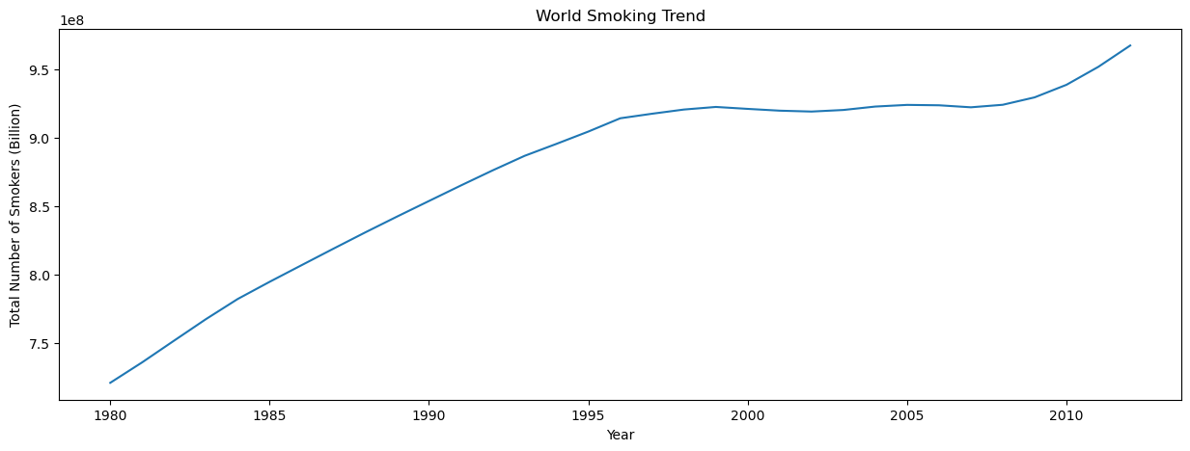
Key findings

Slide 5
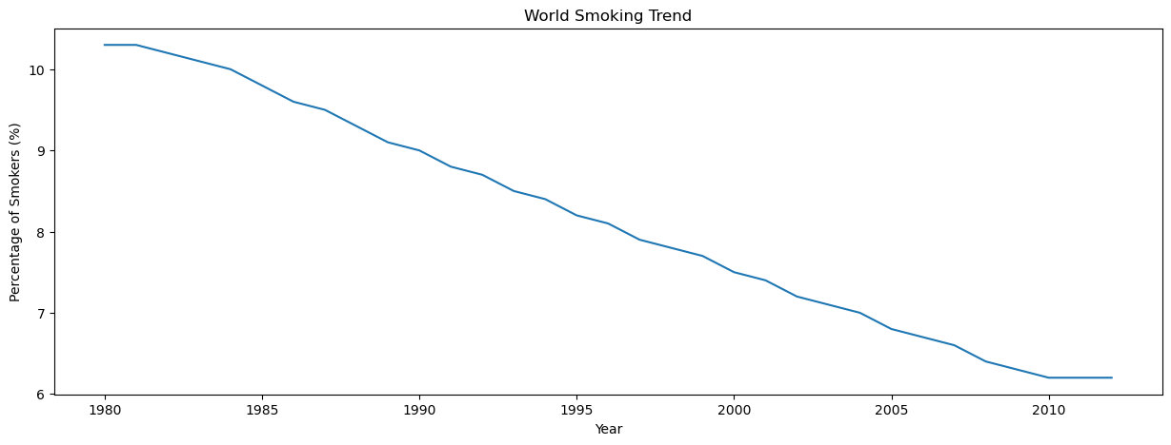
Key findings (cont.)

Slide 6
Key findings (cont.)

Slide 7
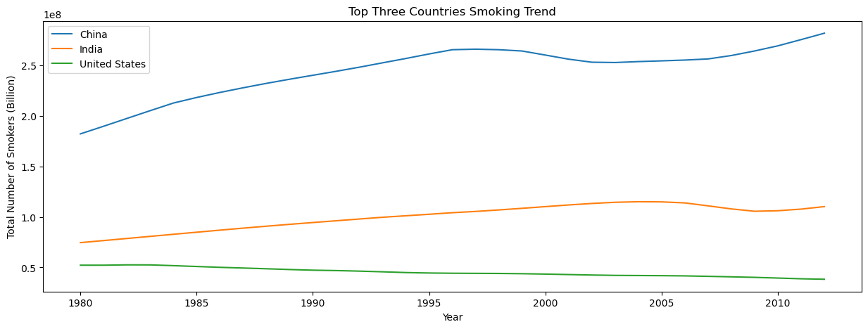
The Breakdown

Slide 8
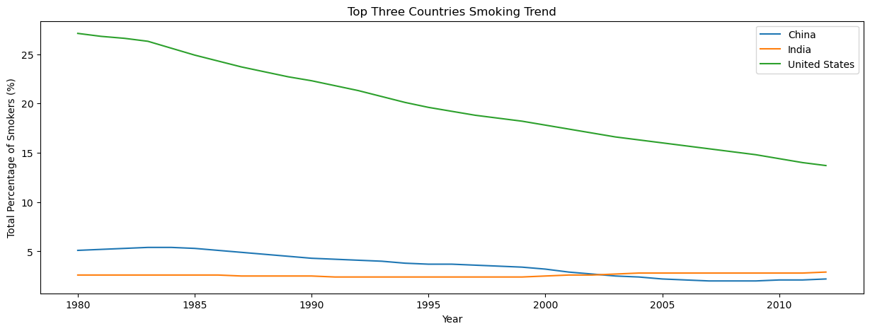
The Breakdown (cont.)

Slide 9
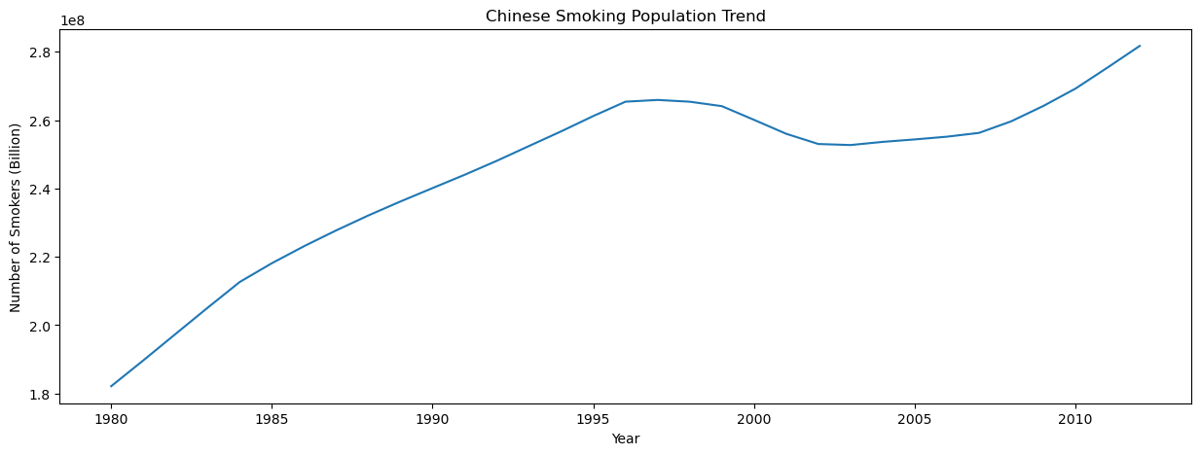
China

Slide 10
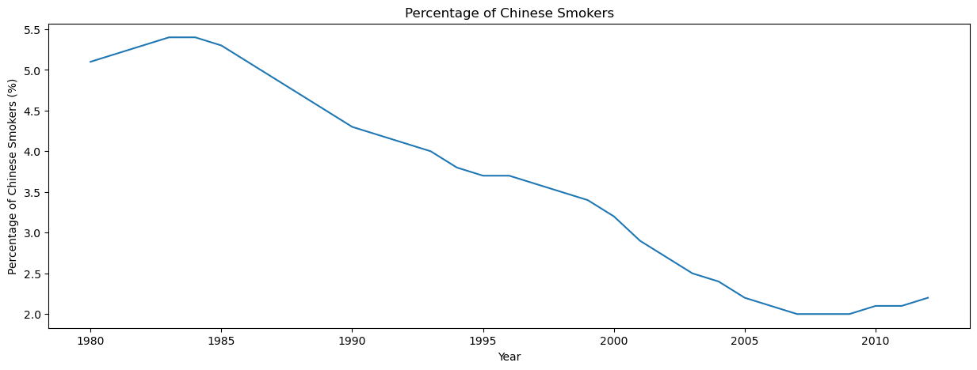
China

Slide 11
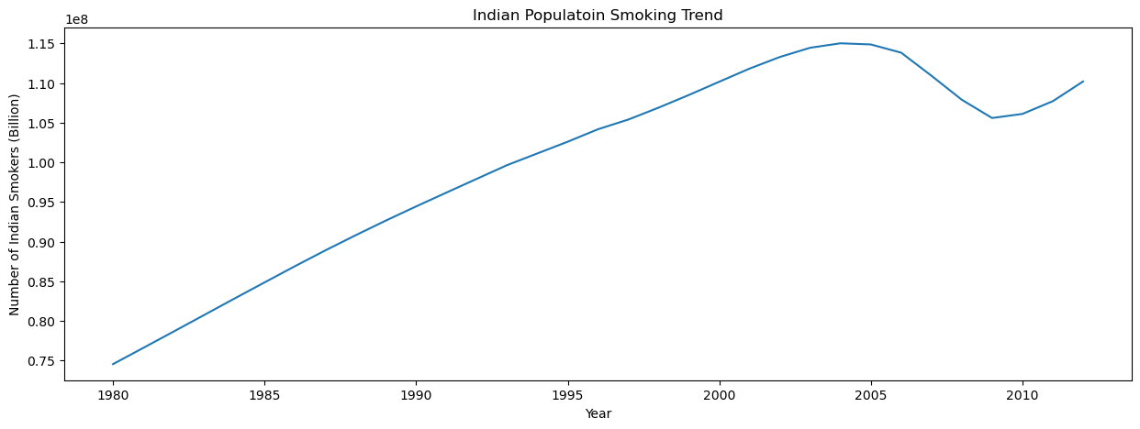
India

Slide 12
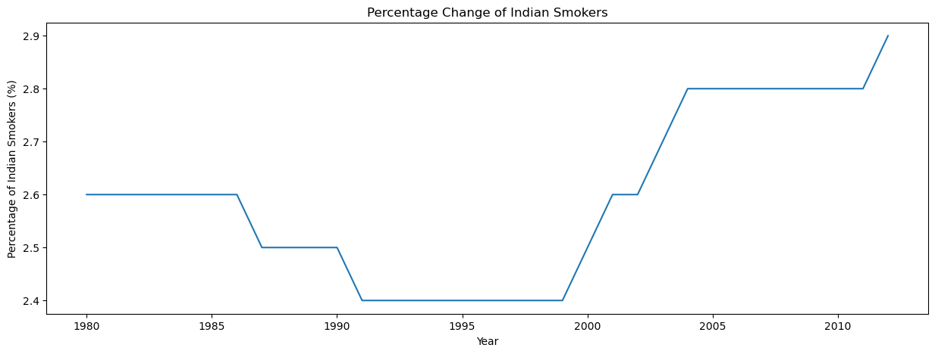
India

Slide 13
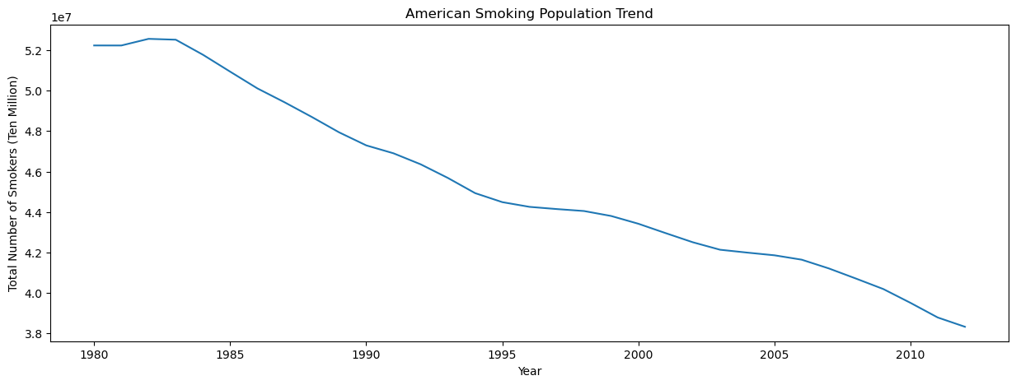
The united states of America

Slide 14
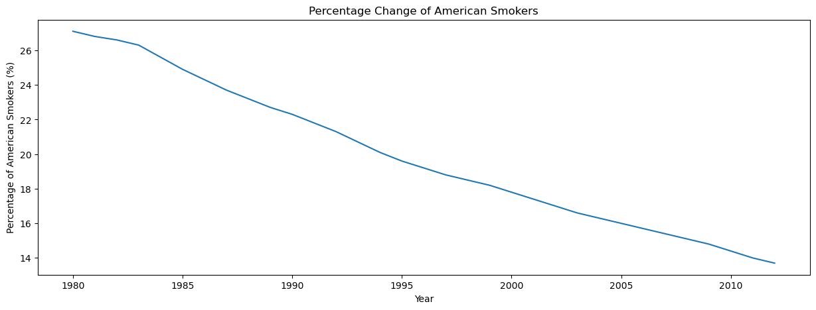
The united states of America

Slide 15
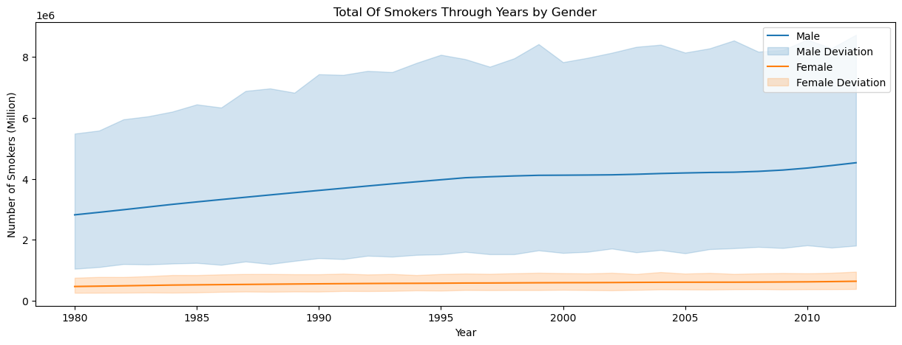
Countries with a positive trend
Notes:
There is a statistically significant difference in percent changes between male and female smokers for countries with positive overall percent change.

Slide 16
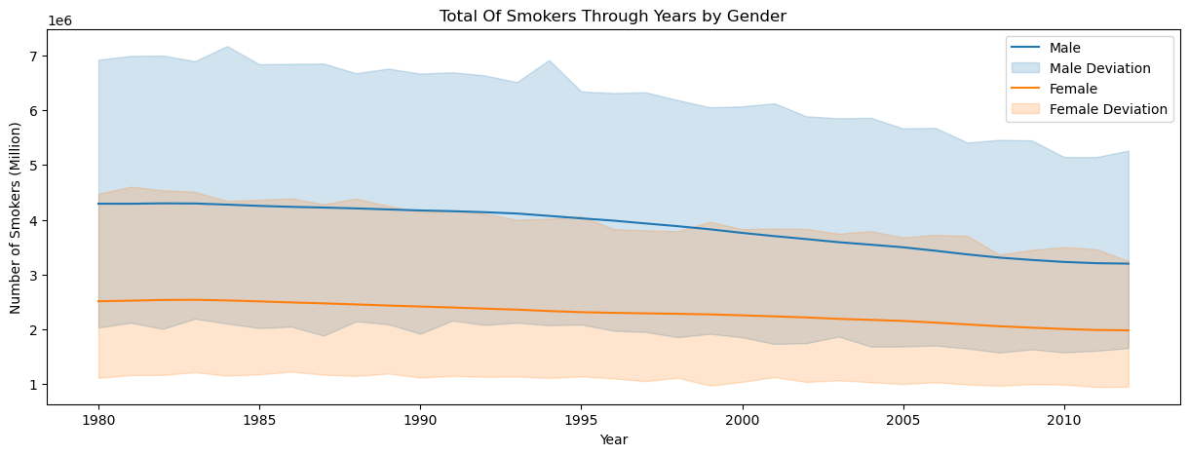
Countries with a negative trend
Notes:
There is no statistically significant difference in percent changes between male and female smokers for countries with negative overall percent change.

Slide 17
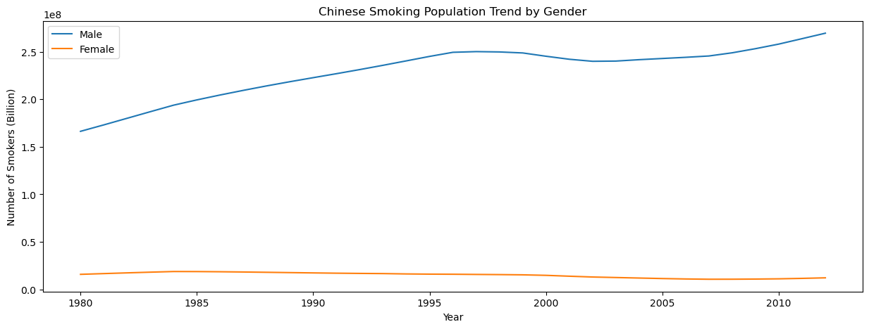
China

Slide 18
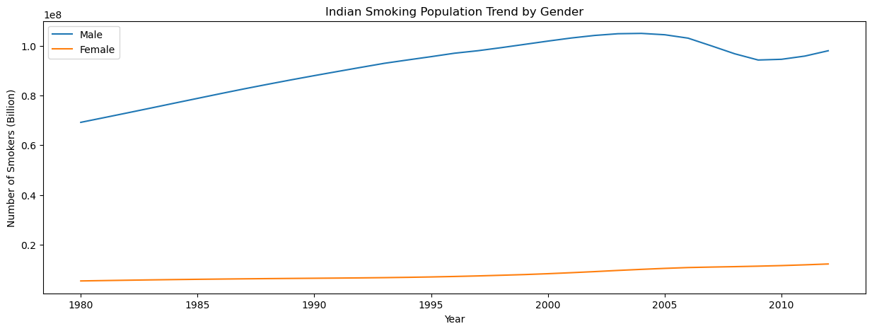
India

Slide 19
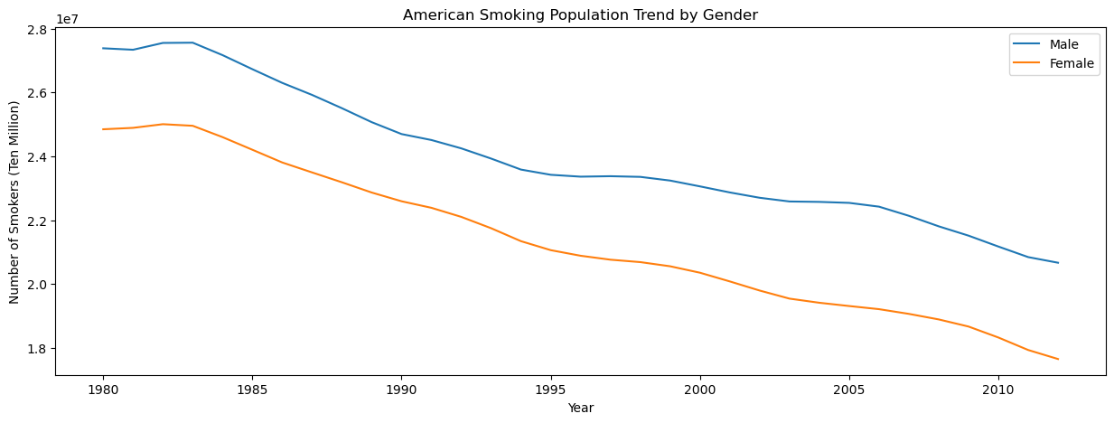
The United states of america

Slide 20
Questions?

